Slide 1
DETECTION OF DIABETIC FOOT ULCER
Done by :
BATCH-13
Monica M (Reg.no:211418104159)
Nagasaranya K (Reg.no:211418104166)
Guided By :
Mrs.V.SathyaPreiya,M.C.A.,M.Phil.,M.E.,
Associate Professor , Department of CSE,
Panimalar Engineering College.

Slide 2
INTRODUCTION
Diabetic foot ulcers are the most common complications of patients having Diabetes Mellitus.
There is 15% - 25% chance that a diabetic patient would develop DFU.
Symptom - The patient with DFU have a problem of swollen leg, itchy and painful feel depending on each case.
Proposed System
  Detection of Diabetic Foot Ulcer
  Domain : Deep Learning
  Convolutional neural network (CNN) is designed to locate the affected region.

Slide 3
LITERATURE SURVEY
Year of Publishing | Author | Title | Observation | Demerits
2021 | Bill Cassidy, Neil D. Reeves et.al | “A Cloud-Based Deep Learning Framework for Remote Detection of Diabetic Foot Ulcers” | This research proposes a mobile and cloud-based framework for the automatic detection of diabetic foot ulcers and conducts an investigation of its performance. | Time consuming and lacks data privacy.
2020 | Javaria Amin,Muhammad Sharif,Habib Ullah Khan | “An Integrated Design for Classification and Localization of Diabetic Foot Ulcer based on YOLOv2-DFU Models” | This research provides the result of classification and localization of Diabetic Foot Ulcer using YOLOv2 model. | Variation in accuracy and YOLOv2 is a time-consuming process
2020 | Dragos Serban, MD, PhD1, Nikolaos Papanas, MD, PhD et.al | “Diabetic Retinopathy in Patients With Diabetic Foot Ulcer: A Systematic Review” | This review discusses the evidence on diabetic retinopathy (DR) in patients with DFU. There is a risk of accelerated progression of DR in non-healing DFUs related to chronic inflammation infection | Time consuming and involves different models

Slide 4
PROBLEM STATEMENT
Globally, 1 out of 11 adults suffer from Diabetes Mellitus.
Diabetic Foot Ulcers is a life-threatening disease, which if not treated properly would lead to amputation.
Current therapies in DFU treatment depend on patient and physician monitoring involving high cost in diagnosis of DFU.
Educating the patients will reduce the risk of complications.
In this paper, we have proposed a cost effective and simple tool for diagnosing DFU.

Slide 5
DEVELOPMENT ENVIRONMENT
HARDWARE ENVIRONMENT:
Processor : Intel Core i5
Hard Disk : 120GB
RAM : 2 GB (Minimum)
Keyboard : 110 Keys enhanced
SOFTWARE ENVIRONMENT:
Operating System : Windows 7+
IDE : Anaconda
Language : Python

Slide 6
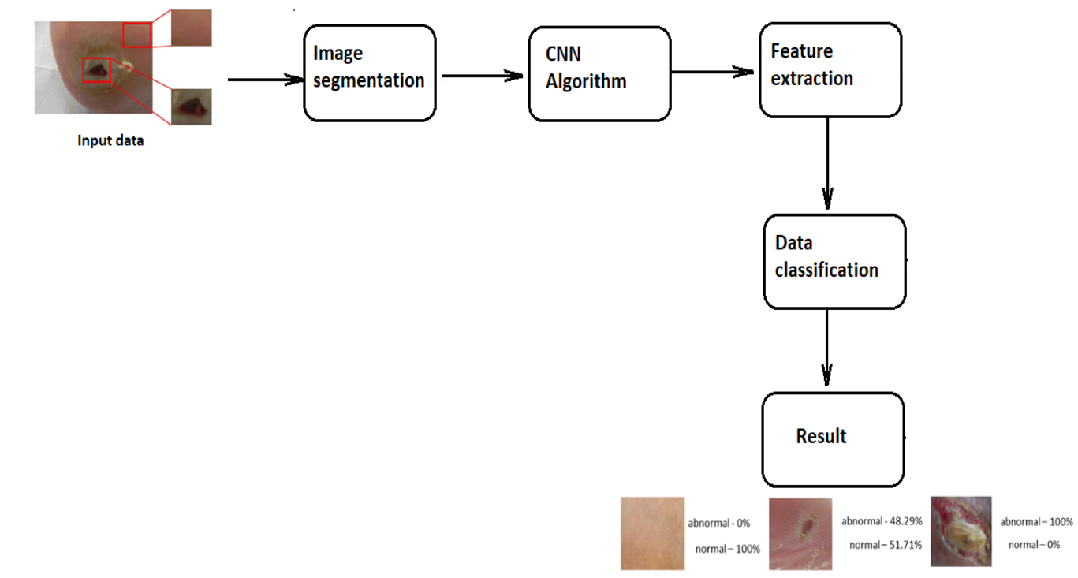
SYSTEM ARCHITECTURE

Slide 7
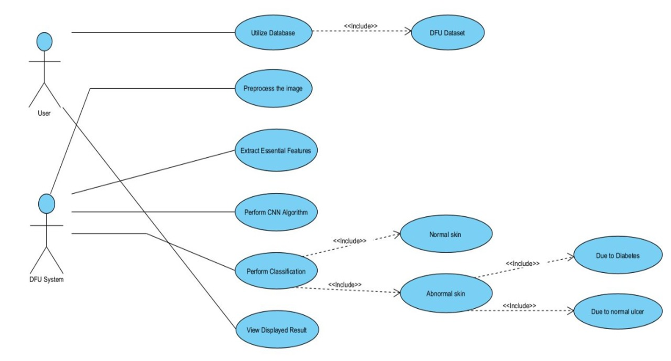
SYSTEM DESIGN
A)USE CASE DIAGRAM

Slide 8
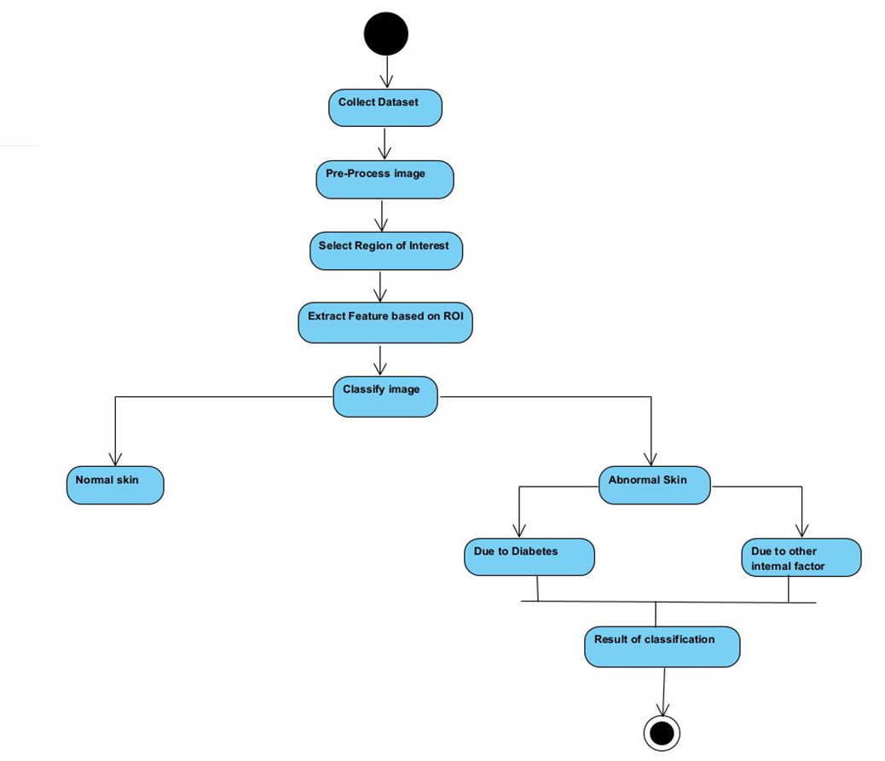
B) ACTIVITY DIAGRAM

Slide 9
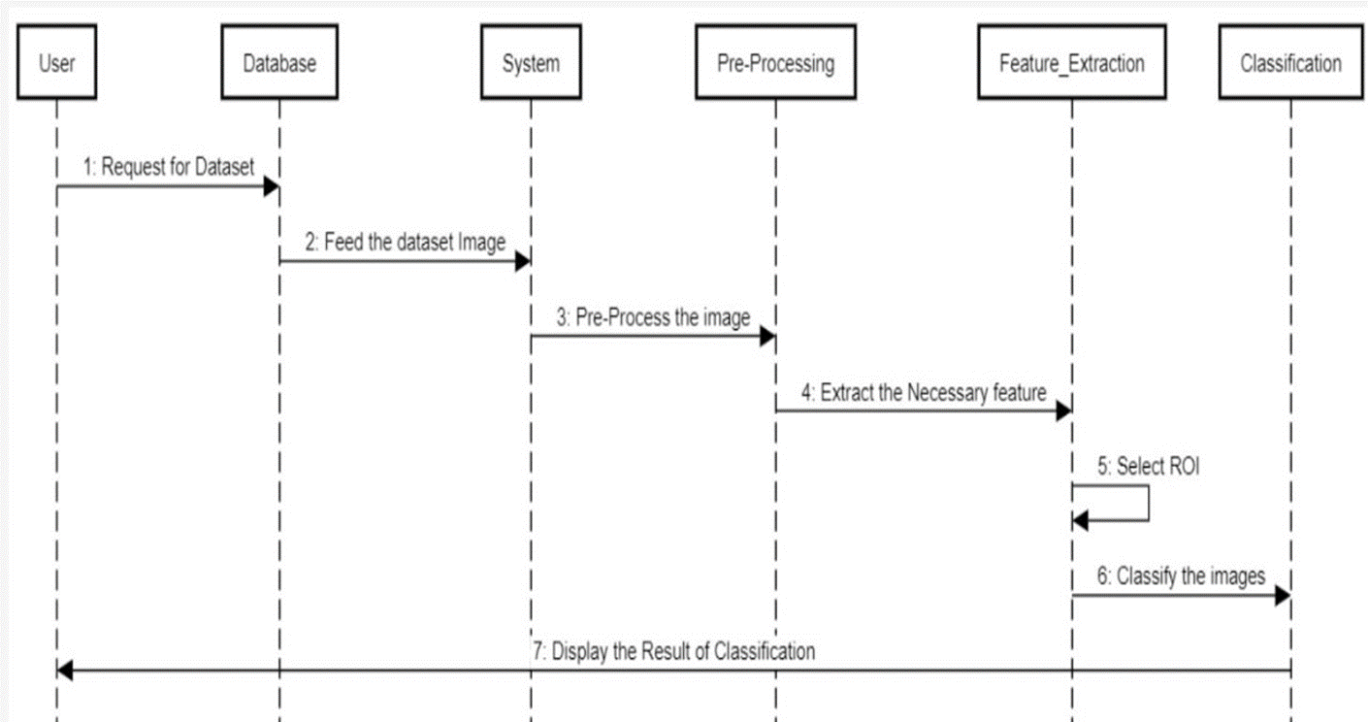
C) SEQUENCE DIAGRAM

Slide 10
D) DFD DIAGRAM
Level 0 (Context Level Diagram) :
Level 1 :
Diabetic Foot Ulcer Detection
Foot Image
Foot Ulcer Classification
CNN Model
(Inception V3)
Test images
Feature Extraction
Foot Ulcer Classification
Trained images

Slide 11
MODULES DESCRIPTION
MODULES
Dataset Collection
Image Pre-processing
Feature extraction
Region of Interest
Classification

Slide 12
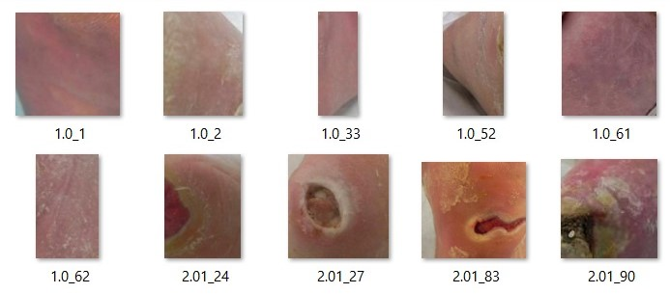
DATASET COLLECTION
A collection of certain high-quality medical metaphors for evaluation.
It is needed for the process of comparison of medical image processing algorithms.
The database has images of normal and affected foot images.

Slide 13
IMAGE PRE-PROCESSING
The foot image is fed as input to the pre-processor for better results.
This enhances the resolution of poor contrast images to get the accurate results.
Steps involved in Pre-Processing are :
        Read the image.
        Resize the image.
        Remove the noise.
        Segmentation.

Slide 14
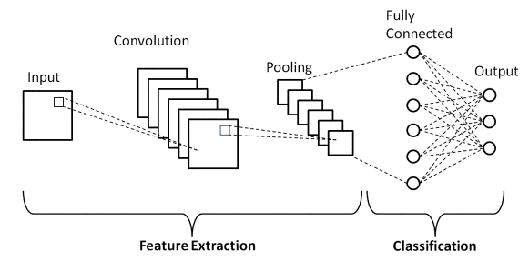
CNN (Convolution Neural Network)
CNN can recognize and classify the particular features from images.
Convolution in CNN means that images can be represented as matrices which are multiplied to give the output.
This output provides the way to extract features from the image.

Slide 15
FEATURE EXTRACTION
The input image contain many features such as texture, colour and shape.
The needed features can be used as mini-information.
It represent the useful information in the image.
It can be used to distinguish between different situations.
A range of texture features and colour features were used to identify the foot ulcer from the image frames.

Slide 16
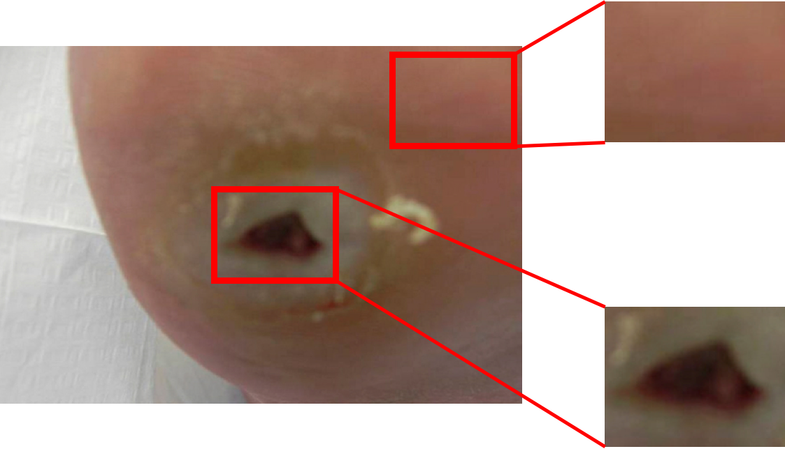
REGION OF INTEREST
ROI acts as a filter to extract the necessary features from the image pixel.
ROI is represented as a binary mask image.
In mask image, the pixels that belong to ROI as set to 0.
The pixels outside the ROI are set to 1.
Pixel outside ROI is set to 1
Pixel inside ROI is set to 0

Slide 17
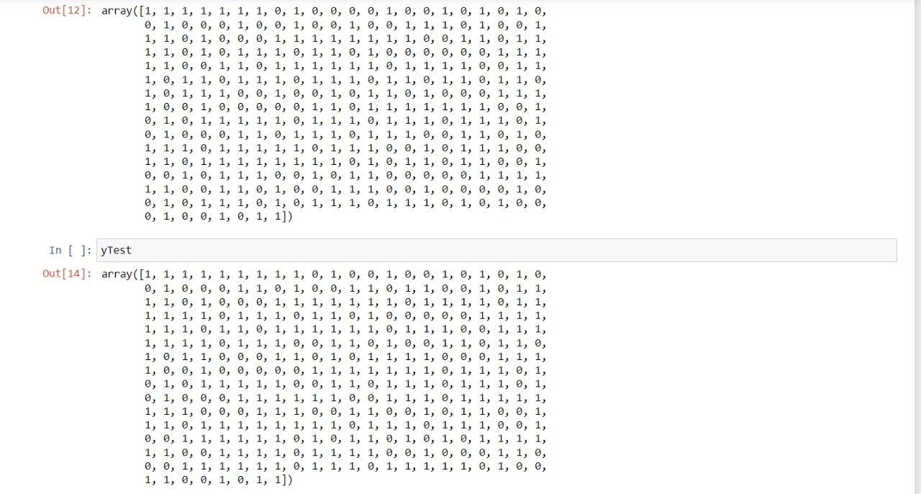
CLASSIFICATION
Image classification is where a computer can analyse an image.
It can identify the category to which the image belongs,
          Class 0 (Healthy Skin)
          Class 1 (Diabetic Foot Ulcer)

Slide 18
TESTING
TEST CASE REPORT – 1
Product : Detection of Diabetic Foot Ulcer
Home Page :
Test Case ID | Test case / Action to Perform | Expected Result | Actual Result | Pass / Fail
1. | Get the URL from idle and open it in the browser | Enters into the home page | Opens the Home Page in the browser | Pass
2. | Choose trained image from folder | Extract the image from folder | Image gets extracted from folder and displayed in home page | Pass
3. | File Upload | Enters into the detection page | Forwards to that particular diabetic foot ulcer detection page | Pass

Slide 19
TEST CASE REPORT – 2
Product : Detection of Diabetic Foot Ulcer
Detection Result Page :
Test case ID | Test case / Action to Perform | Expected Result | Actual Result | Pass / Fail
1. | If the image is a healthy skin | Displays that the image is Healthy skin | Displays that the skin is Healthy and also the Percentage of skin infected. | Pass
2. | If the image is a diabetic foot ulcer skin | Displays that the image is a Diabetic Foot ulcer skin | Displays that the skin is infected by the Diabetic Foot Ulcer and also the percentage of skin infected. | Pass
3. | If the image is a wound | Displays that the image is a Healthy skin | Displays that the skin is healthy and not affected by Diabetic Foot Ulcer and also displays the percentage of skin infected. | Pass

Slide 20
PERFORMANCE ANALYSIS
For the CNN model developed ,we have evaluated the classification performance based on below metrics,
Precision - Precision is the ratio of correctly predicted positive observations to the total predicted positive observations.
Recall (Sensitivity) - Recall is the ratio of correctly predicted positive observations to the all observations in actual class.
F1 score - F1 Score is the weighted average of Precision and Recall.
Accuracy - It is simply a ratio of correctly predicted observation to the total observations.
Specificity - It is the ratio between how much were correctly classified as negative to how much was actually negative.

Slide 21
Key Terms
TP_{DFU} - number of DFU testing data correctly classified as DFU
TN_{DFU} - number of non–DFU testing data correctly classified as Non-DFU
FP_{DFU} - number of non–DFU testing data misclassified as DFU
FN_{DFU} - number of DFU testing data misclassified as Non–DFU.
Formulae
Recall(Sensitivity) = TP / (TP+FN)
Specificity = TN / (TN+FP)
Accuracy = (TP+TN) / Total number of testing data
Precision = TP / (TP+FP)
F1-Score = 2*Precision*Recall / (Precision+Recall)

Slide 22
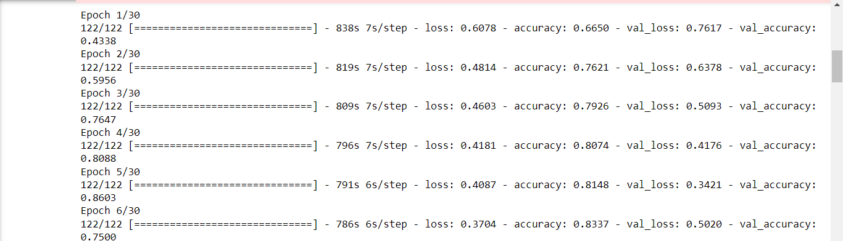
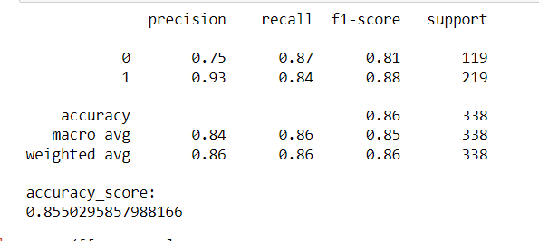
CALCULATION RESULTS
ACCURACY RESULT

Slide 23
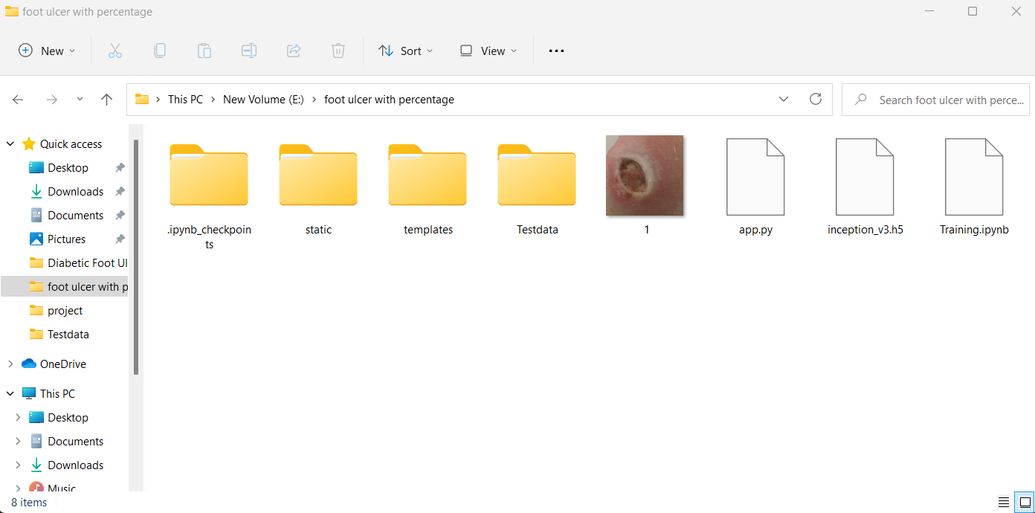
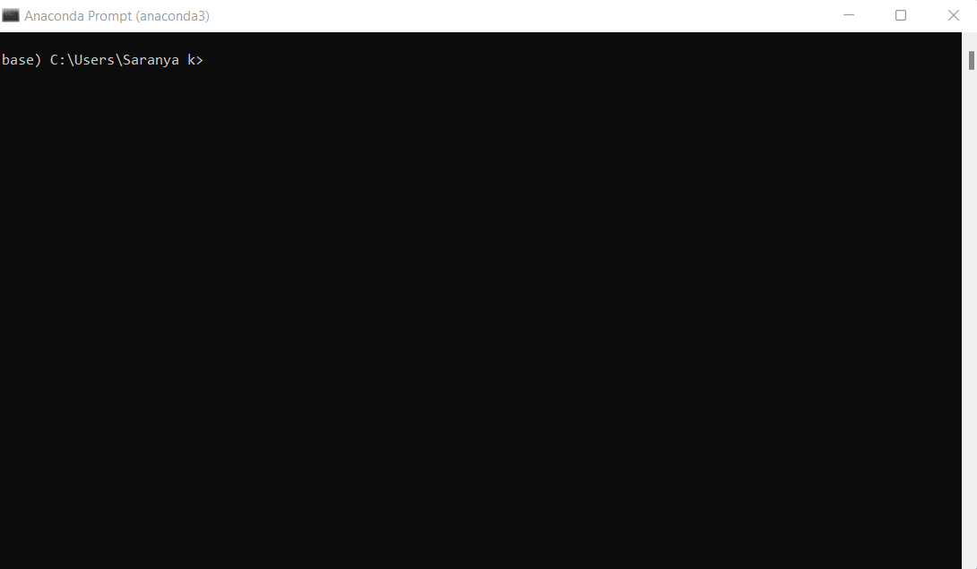
SCREENSHOTS
The below image contains all folders to run complete project.
Open the anaconda prompt

Slide 24
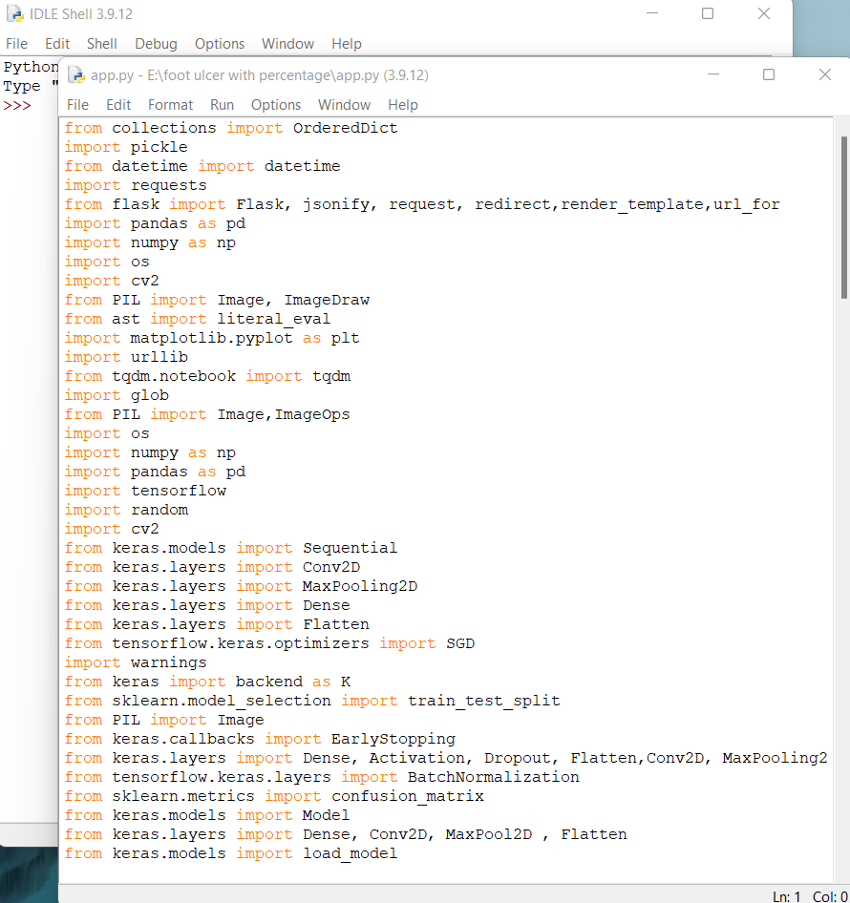
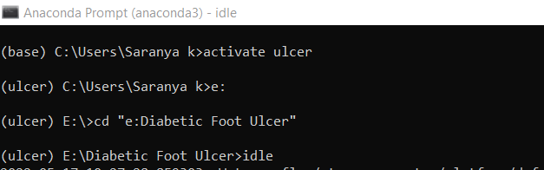
The idle shell opens and then open the app.py file
Type the following command.

Slide 25
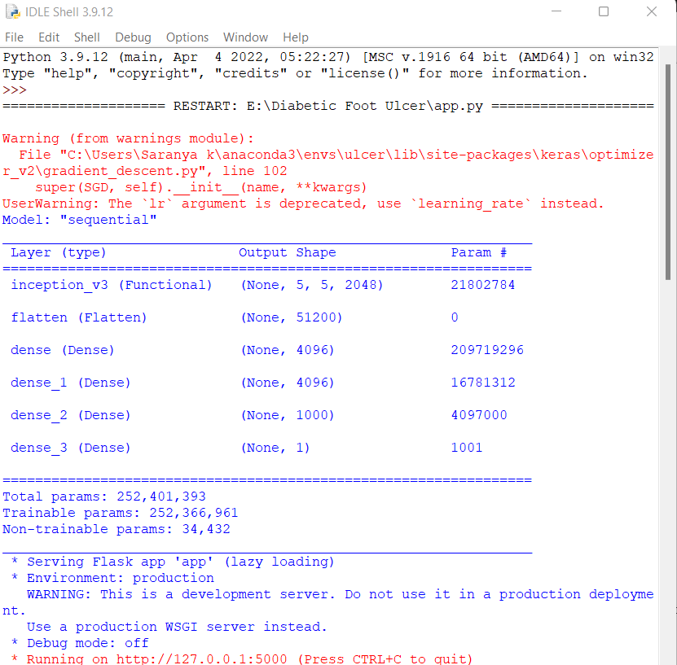
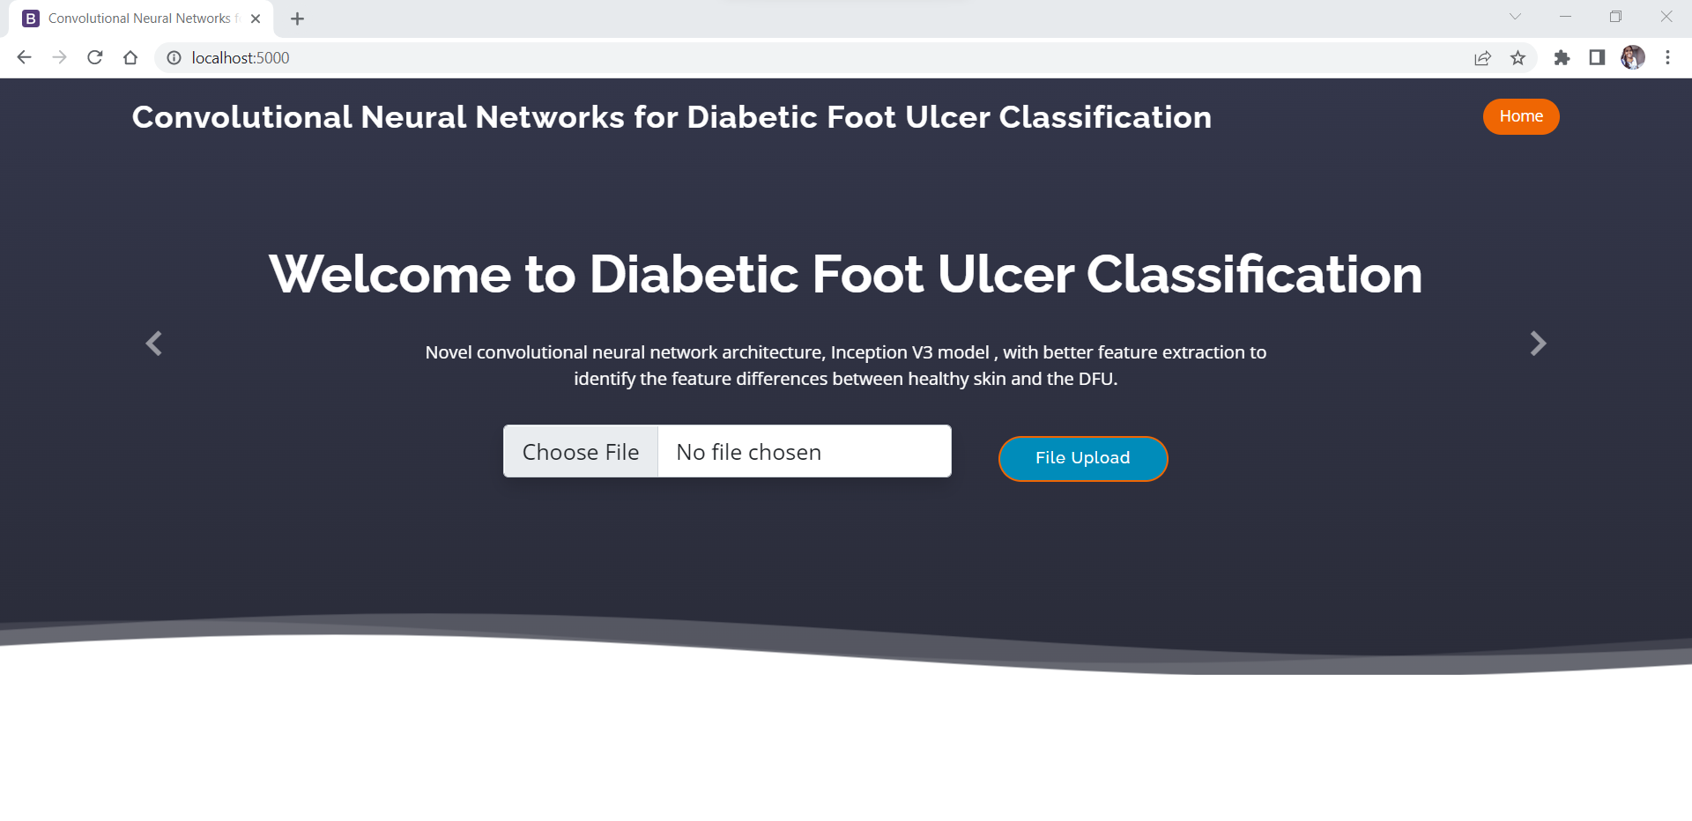
The idle shell after the program runs
The home screen of web app

Slide 26
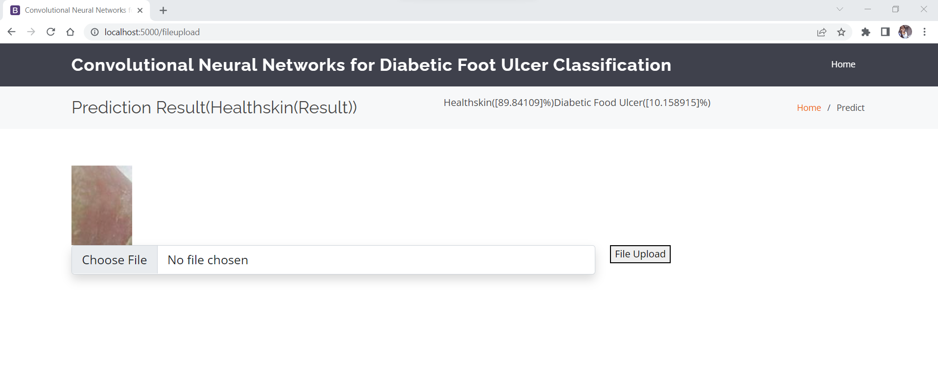
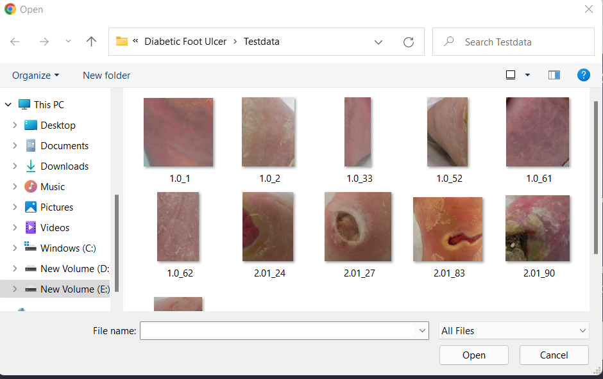
Result of healthy skin
Inserting the images to test

Slide 27
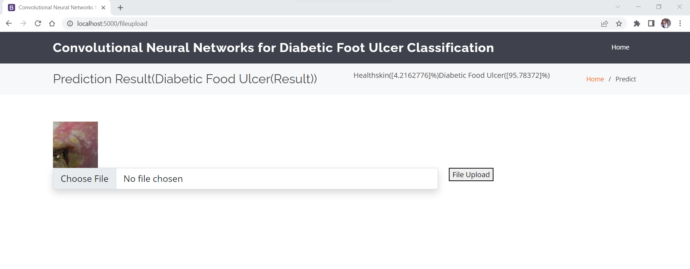
Result of DFU affected skin

Slide 28
CONCLUSION
The CNN architecture for DFU classification discriminates the DFU skin from healthy skin.
It allows the accurate automated detection of DFU in foot images and make it an innovative technique for DFU evaluation and medical treatment.
The study employs a flexible and efficient approach of machine learning by applying the model of CNN .
The models presented could achieve 85% accuracy.
Thus, it is concluded that CNN classiﬁer therefore, be effective.

Slide 29
REFERENCES
[1] Matilde Monteiro-Soares, Edward J. Boyko et.al “Diabetic foot ulcer classifications: A critical review” Wiley Online Library 16 March 2020
[2] Mayland Chang and Trung T. Nguyen “Strategy for Treatment of Infected Diabetic Foot Ulcers” 2021 American Chemical Society
[3] Moi Hoon Yap a , Ryo Hachiuma et.al “Deep learning in diabetic foot ulcers detection: A comprehensive evaluation” Computers in Biology and Medicine (2021)
[4] Paola C. Aldana ,Amor Khachemoune et.al “Diabetic Foot Ulcers: Appraising Standard of Care and Reviewing New Trends in Management” American Journal of Clinical Dermatology 17 December 2019.

Slide 30
[5] Danielle Dixon, Michael Edmonds et.al “Managing Diabetic Foot Ulcers: Pharmacotherapy for Wound Healing” Springer Nature Switzerland AG 2020.
[6] Dragos Serban, MD, PhD1, Nikolaos Papanas, MD, PhD et.al “Diabetic Retinopathy in Patients With Diabetic Foot Ulcer: A Systematic Review” The International Journal of Lower Extremity Wounds 2020
[7] Morica M. Tran and Melanie N. Haley “Does exercise improve healing of diabetic foot ulcers? A systematic review” Journal of Foot and Ankle Research (2021)
[8] Moi Hoon Yap, Bill Cassidy et.al “Analysis Towards Classification of Infection and Ischaemia of Diabetic Foot Ulcers” 2021 IEEE EMBS International Conference on Biomedical and Health Informatics (BHI).

Slide 31
[9] Bill Cassidy, Neil D Reeves, Joseph M Pappachan et.al “The DFUC 2020 Dataset: Analysis Towards Diabetic Foot Ulcer Detection” TouchREV Endocrinol. 2021 Apr 28.
[10] Bill Cassidy, Neil D. Reeves et.al “A Cloud-Based Deep Learning Framework for Remote Detection of Diabetic Foot Ulcers” IEEE Pervasive Computing ( Early Access )14 January 2021.

Slide 32
THANK YOU

